Slide 1


NETWORK PROTOCOLS & SECURITY 24EC2210
Topic:
ERROR CONTROL
Session –8 &9 8&9

Slide 2













AIM OF THE SESSION
To familiarize students with the basic idea of Error Control in Data link layer.
INSTRUCTIONAL OBJECTIVES
This Session is designed to:
Describe different types of errors.
Understand different types of error detection methods.
Understand error correction mechanism.
LEARNING OUTCOMES
At the end of this session, you should be able to:
Identify the types of errors.
Apply different error detection techniques to identify the error.
Apply hamming code to detect and correct the error in the data.

Slide 3
Error Detection and Correction
Types of Errors
Detection
Error Correction

Slide 4

Introduction
Data can be corrupted during transmission. communication, error must be detected and corrected.
For reliable
Error Detection and Correction are implemented either at the data link layer or the transport layer of the OSI model.

Slide 5
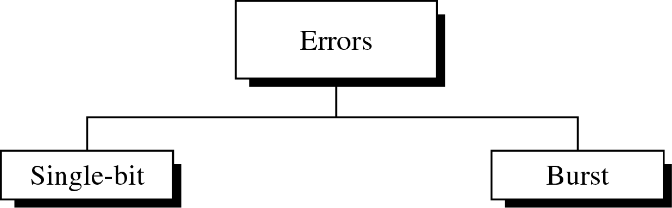
Type of Errors

Slide 6
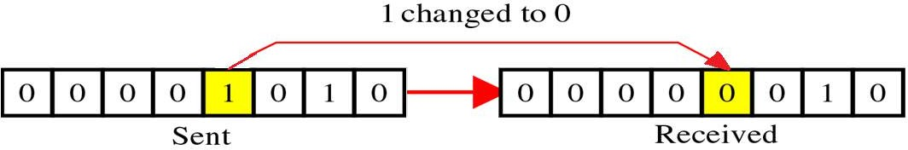
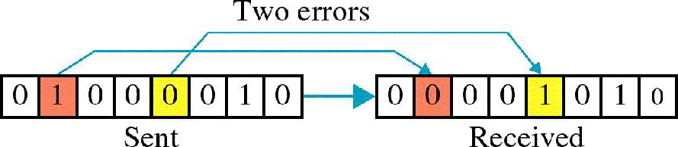
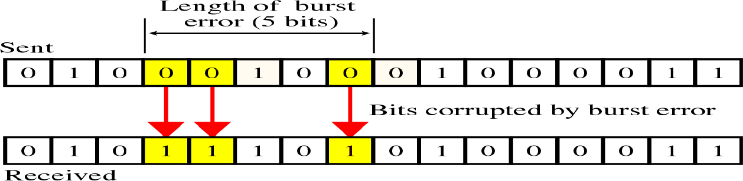
Type of Errors(cont’d)
Single-Bit Error: Only one bit in the data unit has changed
Multiple-Bit Error: Two or more nonconsecutive bits in the data unit have changed.
Burst Error: Two or more consecutive bits in the data unit have changed

Slide 7

Type of Errors(cont’d)
Multiple-Bit Error: is when two or more nonconsecutive bits in the data unit have changed.

Slide 8
Type of Errors(cont’d)
Burst Error means that 2 or more consecutive bits in the data unit have changed

Slide 9
Error Detection
9

Slide 10






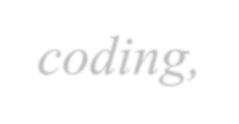









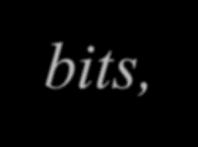






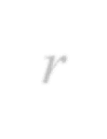

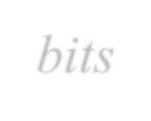






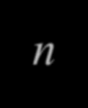


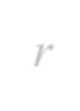








Error Detection
Error detection uses the concept of redundancy, which means adding extra bits for detecting errors at the destination.
BLOCK CODING:
In block coding, we divide our message into blocks, each of k bits, called datawords.
We add r redundant bits to each block to make the length n = k + r.
The resulting n-bit blocks are called codewords.

Slide 11
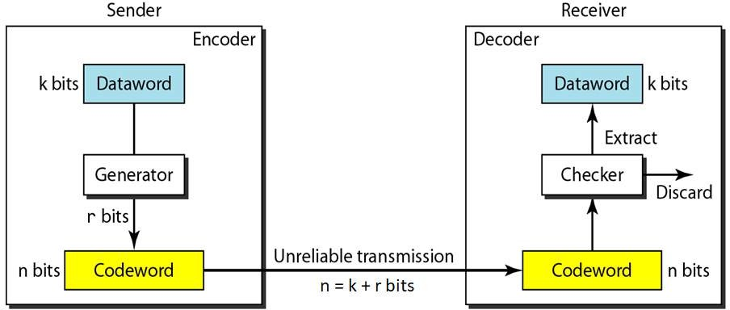
The structure of encoder and decoder
To detect or correct errors, we need to send redundant bits
11

Slide 12
Error Detection Methods
© 2016 KL University – The contents of this presentation are an intellectual and copyrighted property of KL University. ALL RIGHTS RESERVED
12

Slide 13
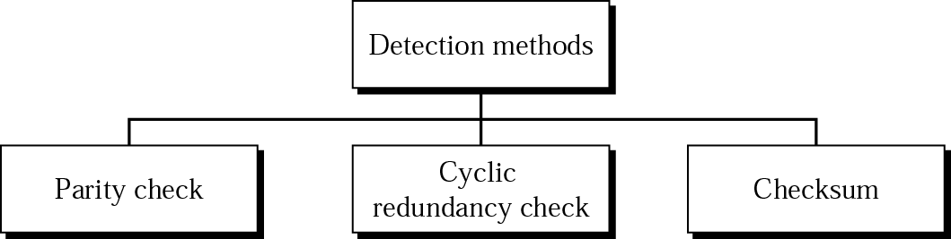
Error Detection Methods
Detection methods

Slide 14
1. Parity Method
14

Slide 15

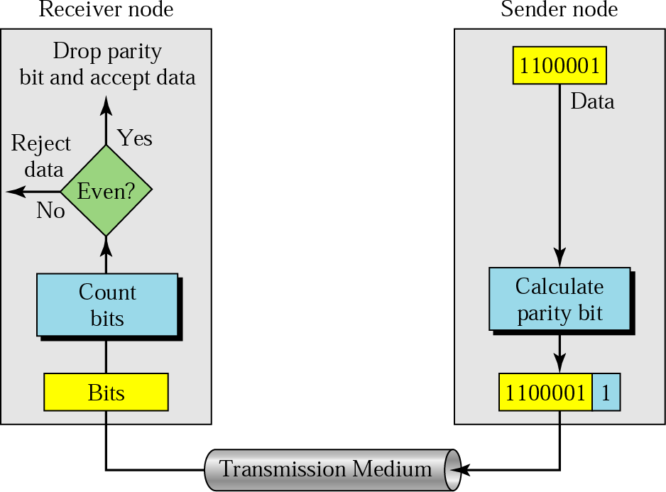
Simple Parity Method
Parity Check:
A parity bit is added to every data unit so that the total number of 1s(including the parity bit) becomes even for even-parity check or odd for odd-parity check.
Simple parity check

Slide 16

Parity method examples
Example 1
Suppose the sender wants to send the word “world”. In ASCII the five characters are coded as
1110111 |  | 1101111 |  | 1110010 |  | 1101100 | 1100100
Sent data:
11101110 |  | 11011110 |  | 11100100 |  | 11011000 | 11001001

Slide 17
Drawback of Simple Parity
M = 1100101
Parity followed: Even
Sent Message | Received Message | Parity | Message Status
11001010 | 11001110 | Odd | Discard
11001010 | 11101110 | Even | Accept
11001010 | 11101100 | Odd | Discard
11001010 | 10101100 | Even | Accept
Disadvantage: With Simple parity method, only the odd number errors can be detected.
© 2016 KL University – The contents of this presentation are an intellectual and copyrighted property of KL University. ALL RIGHTS RESERVED
17

Slide 18



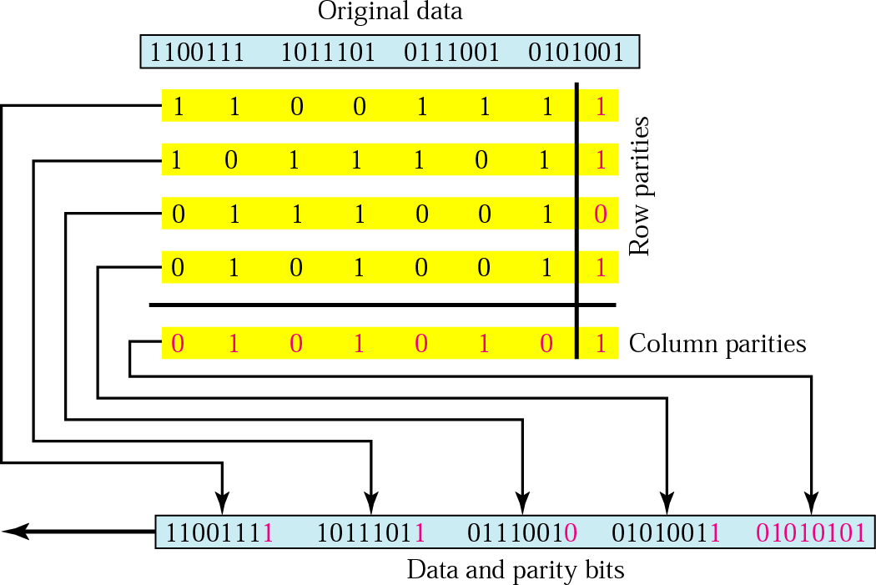
Two-Dimensional Parity Method

Slide 19
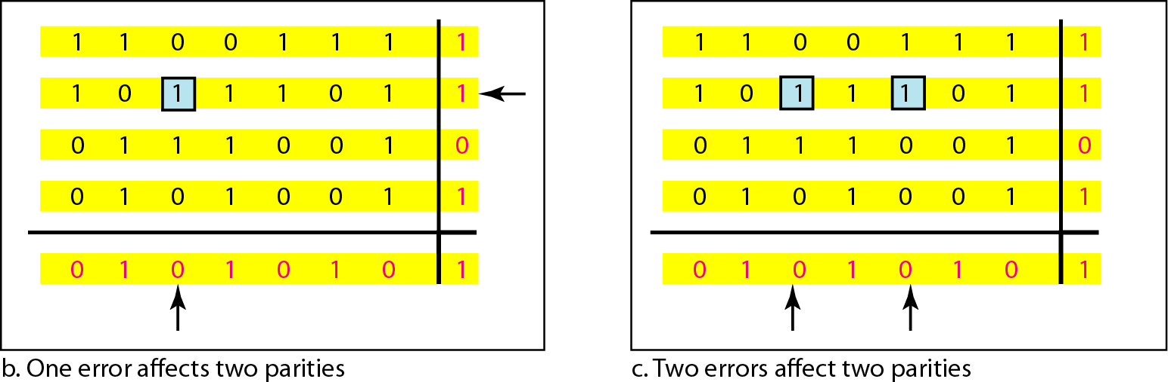
Two-dimensional parity-check code

Slide 20
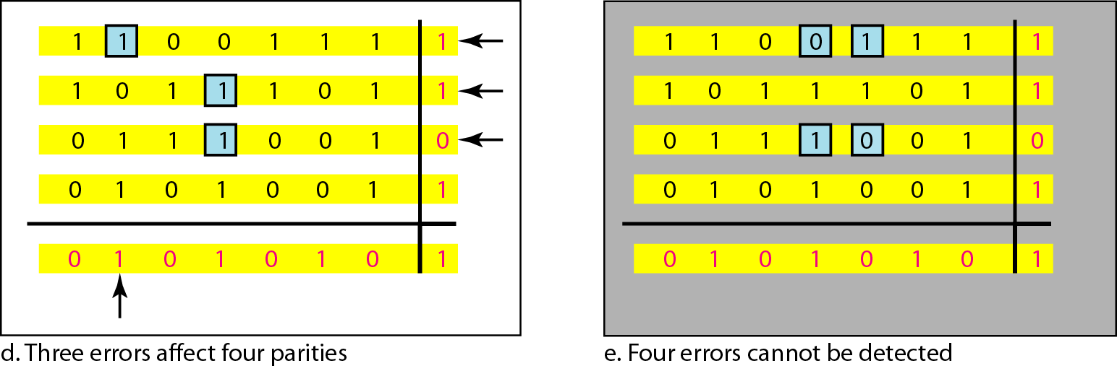
Two-dimensional parity-check code…

Slide 21
2. Cyclic Redundancy Check (CRC)

Slide 22
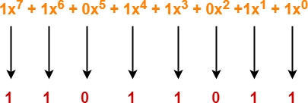
2. Cyclic Redundancy Check (CRC):
Cyclic Redundancy Check (CRC) is an error detection method.
It is based on binary division.
CRC Generator-
CRC generator is an algebraic polynomial represented as a bit pattern.
Bit pattern is obtained from the CRC generator using the following rule-
The power of each term gives the position of the bit and the coefficient gives the value of the bit.
Example-
Consider the CRC generator is x⁷ + x⁶ + x⁴ + x³ + x + 1. The corresponding binary pattern is obtained as-

Slide 23
Steps in Computing CRC:
Step-01: Calculation Of CRC At Sender Side-
At sender side,
A string of n 0’s is appended to the data unit to be transmitted.
Here, n is one less than the number of bits in CRC generator.
Binary division is performed of the resultant string with the CRC generator.
After division, the remainder so obtained is called as CRC.
It may be noted that CRC also consists of n bits.
Step-02: Appending CRC To Data Unit-
At sender side,
The CRC is obtained after the binary division.
The string of n 0’s appended to the data unit earlier is replaced by the CRC remainder.
Step-03: Transmission To Receiver-
The newly formed code word (Original data + CRC) is transmitted to the receiver.

Slide 24
Steps in Computing CRC…
Step-04: Checking at Receiver Side-
At receiver side,
The transmitted code word is received.
The received code word is divided with the same CRC generator.
On division, the remainder so obtained is checked.
The following two cases are possible- Case-01: Remainder = 0
If the remainder is zero,
Receiver assumes that no error occurred in the data during the transmission.
Receiver accepts the data.
Case-02: Remainder ≠ 0
If the remainder is non-zero,
Receiver assumes that some error occurred in the data during the transmission.
Receiver rejects the data and asks the sender for retransmission.
24

Slide 25

CRC Example
A bit stream 11101101 is to be transmitted using the standard CRC method. The generator polynomial given is x³+1.
What is the actual bit string transmitted?
Suppose the third bit from the left is inverted during transmission. How will receiver detect this error?

Slide 26
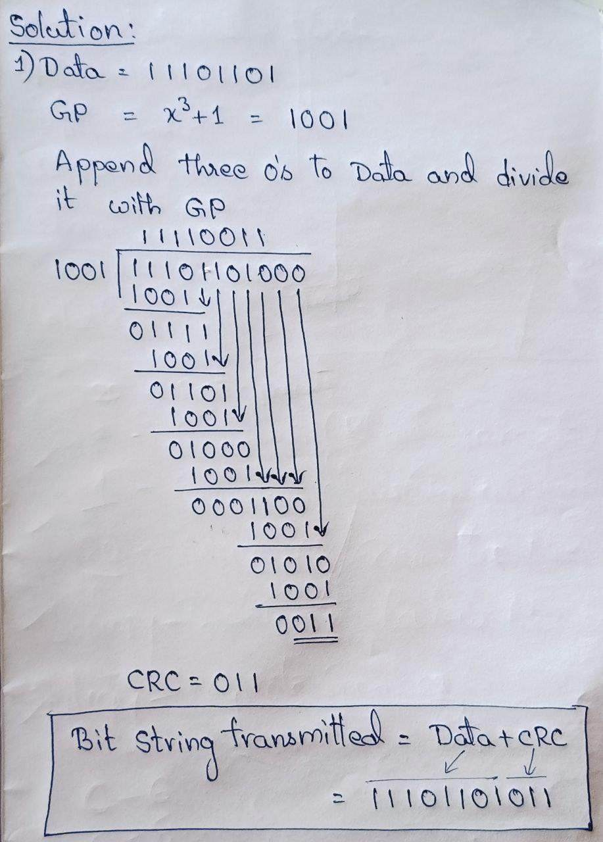
CRC Example : Solution

Slide 27
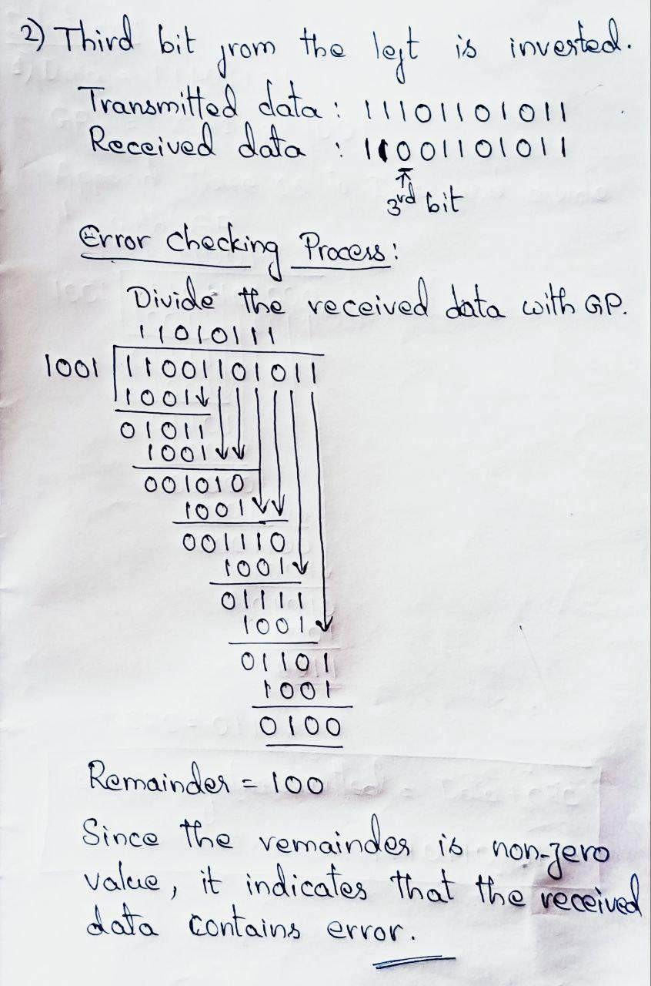
CRC Example : Solution

Slide 28
3. Checksum

Slide 29
3. Checksum…
Checksum is the error detection method used by upper layer protocols and is considered to be more reliable than Parity and CRC.
For error detection by checksums, data is divided into fixed sized frames or
segments.
Sender’s End − The sender adds the segments using 1’s complement arithmetic to
get the sum. It then complements the sum to get the checksum and sends it along with the data frames.
Receiver’s End − The receiver adds the incoming segments along with the
checksum using 1’s complement arithmetic to get the sum and then complements it.
If the result is zero, the received frames are accepted; otherwise they are discarded.

Slide 30
3. Checksum…
Example: Suppose that the sender wants to send 4 frames each of 8 bits, where the frames are 11001100, 10101010, 11110000 and 11000011.
The sender adds the bits using 1s complement arithmetic. While adding two numbers using 1s complement arithmetic, if there is a carry over, it is added to the sum.
After adding all the 4 frames, the sender complements the sum to get the checksum,
11010011, and sends it along with the data frames.
11001100 | 10101010 | 11110000 | 11000011 | 11010011
The receiver performs 1s complement arithmetic sum of all the frames including the checksum. The result is complemented and found to be 0. Hence, the receiver assumes that no error has occurred.

Slide 31
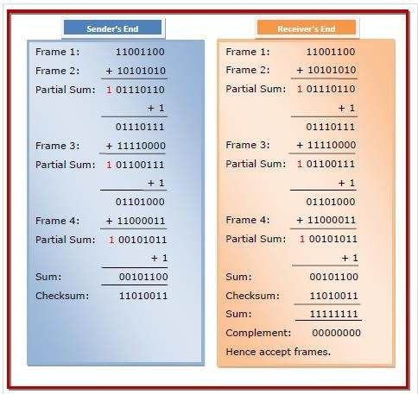

Slide 32
Practice Questions
The message 1101011011 is to be transmitted using the generator polynomial x4+x+1 to protect it from errors. Find the final data to be transmitted after performing CRC.
Original data is 10110011 10101011 01011010 11010101. Perform 2D parity and compute the codeword.
Original data is 10110011 10101011 01011010 11010101. Find out the checksum to detect error.

Slide 33
Error Correction

Slide 34
Error Correction
Error-correcting codes (ECC) are a sequence of numbers generated by specific algorithms for detecting and removing errors in data that has been transmitted over noisy channels.
Hamming Code is a block code that is capable of detecting up to two simultaneous bit errors and correcting single-bit errors. It was developed by R.W. Hamming for error correction.

Slide 35
Hamming Code
Encoding a message by Hamming Code:
The procedure used by the sender to encode the message encompasses the following steps −
Step 1 − Calculation of the number of redundant bits. ( 2^{r} ≥ m+r+1 )
Step 2 − Positioning the redundant bits.
(r redundant bits placed at bit positions of powers of 2)
Step 3 − Calculating the values of each redundant bit.
(bit positions whose binary representation includes a 1 in the i^{th} position)
Once the redundant bits are embedded within the message, this is sent to the user.

Slide 36
Hamming Code…
Decoding a message in Hamming Code:
Once the receiver gets an incoming message, it performs parity checking.
Parity bits are calculated based upon the data bits and the redundant bits using the same rule as during generation of c1,c2 ,c3 ,c4 etc. Thus
c1 = parity(1, 3, 5, 7, 9, 11 and so on)
c2 = parity(2, 3, 6, 7, 10, 11 and so on) c3 = parity(4-7, 12-15, 20-23 and so on)
The decimal equivalent of the parity bits binary values is calculated. If it is 0, there is no error. Otherwise, the decimal value gives the bit position which has error.
© 2016 KL University – The contents of this presentation are an intellectual and copyrighted property of KL University. ALL RIGHTS RESERVED
35

Slide 37
Hamming Code Example
1. a) Shradha is transmitting data-1101 to her friend. For security reasons, Shradha wishes to send data by implementing the Hamming Code technique so as to make sure of error control. Help Shradha in performing the above (Assume Even parity).
b) Also show the error detection process done by Shradha’s friend for the following cases.
Case1: Received data is correct.
Case2: Second bit from left is changed.

Slide 38
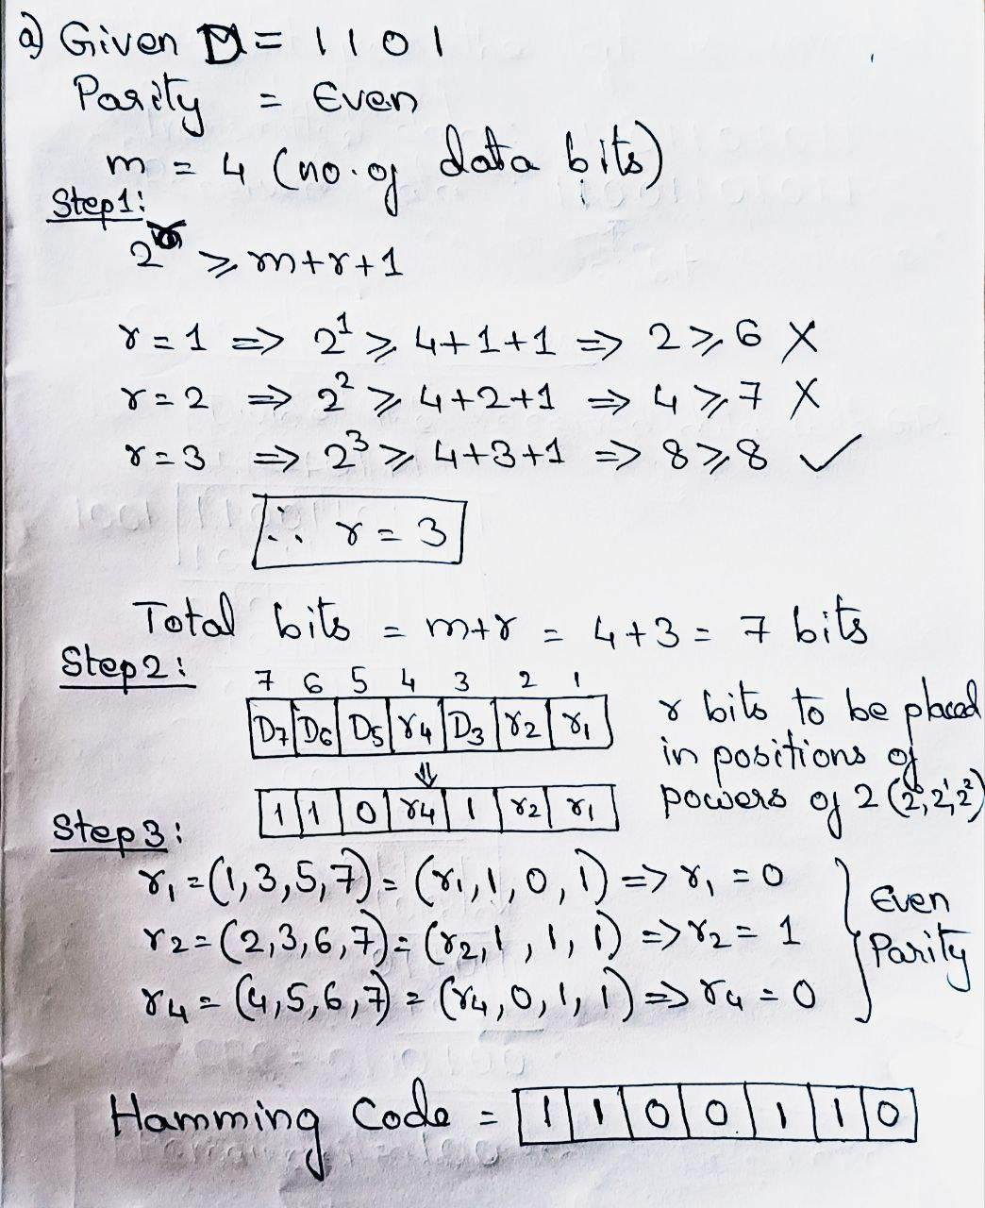
Hamming Code : Solution

Slide 39
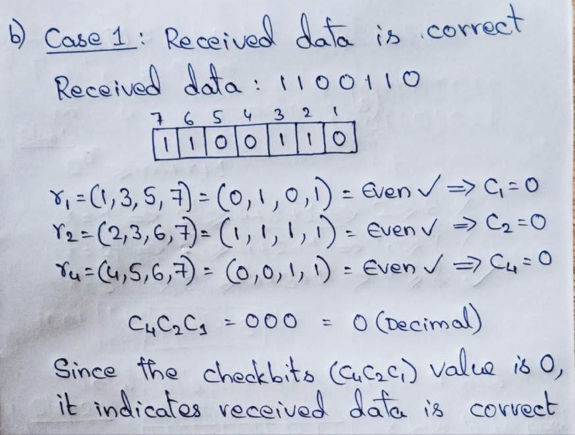
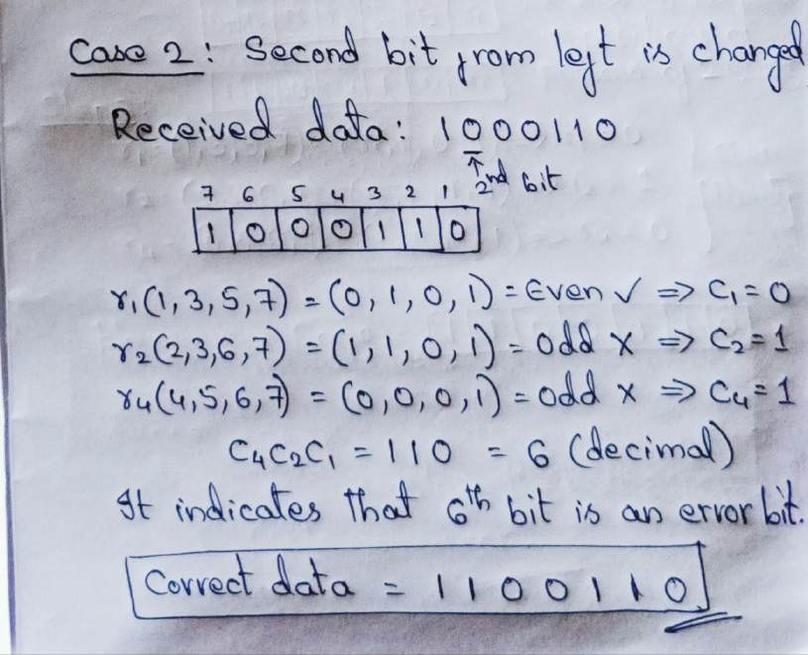
Hamming Code : Solution

Slide 40

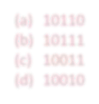


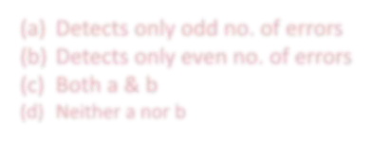


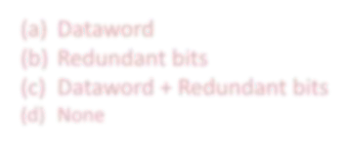


SELF-ASSESSMENT QUESTIONS
1. What is the codeword for the dataword 1011 when even parity is used?
(a) | 10110
(b) | 10111
(c) | 10011
(d) | 10010
2. | What is the drawback of simple parity method?
Detects only odd no. of errors
Detects only even no. of errors
Both a & b
Neither a nor b
3. Codeword means?
(a)
(b)
(c)
(d)
Dataword
Redundant bits
Dataword + Redundant bits
None

Slide 41
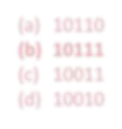
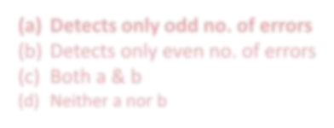
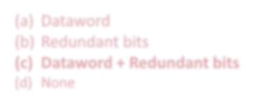
SELF-ASSESSMENT QUESTIONS
1. What is the codeword for the dataword 1011 when even parity is used?
(a) | 10110
(b) | 10111
(c) | 10011
(d) | 10010
2. | What is the drawback of simple parity method?
Detects only odd no. of errors
Detects only even no. of errors
Both a & b
Neither a nor b
3. Codeword means?
(a)
(b)
(c)
(d)
Dataword
Redundant bits
Dataword + Redundant bits
None

Slide 42


SUMMARY
Types of Errors
Error Detection Methods
Error Correction Methods

Slide 43

TERMINAL QUESTIONS
The message 1101011011 is to be transmitted using the generator polynomial x4+x+1 to protect it
from errors. Find the final data to be transmitted after performing CRC.
Original data is 10110011 10101011 01011010 11010101. Perform 2D parity and compute the codeword.
Original data is 10110011 10101011 01011010 11010101. Find out the checksum to detect error.
Similarly, if Shradha is receiving a 7-bit hamming code 1011101, assume Even parity and state whether received data is correct or not. If not locate the error bit?

Slide 44

REFERENCES FOR FURTHER LEARNING OF THE SESSION
Reference Books:
A.S. Tanenbaum, David J. Wetheral “Computer Networks” Pearson, 5th Edition.
Kurose, J and Ross, K Computer Networking: A Top-Down Approach Addison-Wesley- 6th edition.
Sites and Web links:
https://www.tutorialspoint.com/data_communication_computer_network/error_detection_and_ correction.htm

Slide 45


THANK YOU
Team – Network Protocols & Security

